Slide 1
Fighting COVID-19 in underserved communities with COVID-19 Buddy App
Website: https://covid-buddy.herokuapp.com
GitHub: https://github.com/nongnoochr/covid-buddy

Slide 2

COVID-19 is responsible
for at least
3 million
excess deaths
in 2020

Slide 3

Not only the virus is so deadly…
According to a study published by the National Bureau of Economic Research
Areas of the country exposed to television programming that downplayed the severity of the pandemic saw
greater numbers of cases and deaths
because people didn’t follow public health precautions
source: https://www.scientificamerican.com/article/covid-misinformation-is-killing-people1/

Slide 4

This problem is amplified in underserved communities
with
Lack of access to Healthcare

Slide 5

COVID-19 Buddy app is a trustworthy assistant to fight COVID-19 disinformation & Lack of access to Healthcare

Slide 6

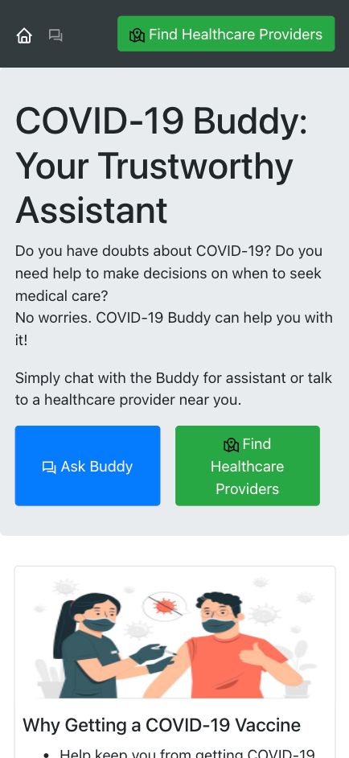



COVID-19 Buddy

Slide 7



Buddy
Quick Guide

Slide 8
Buddy
Quick Guide

Slide 9
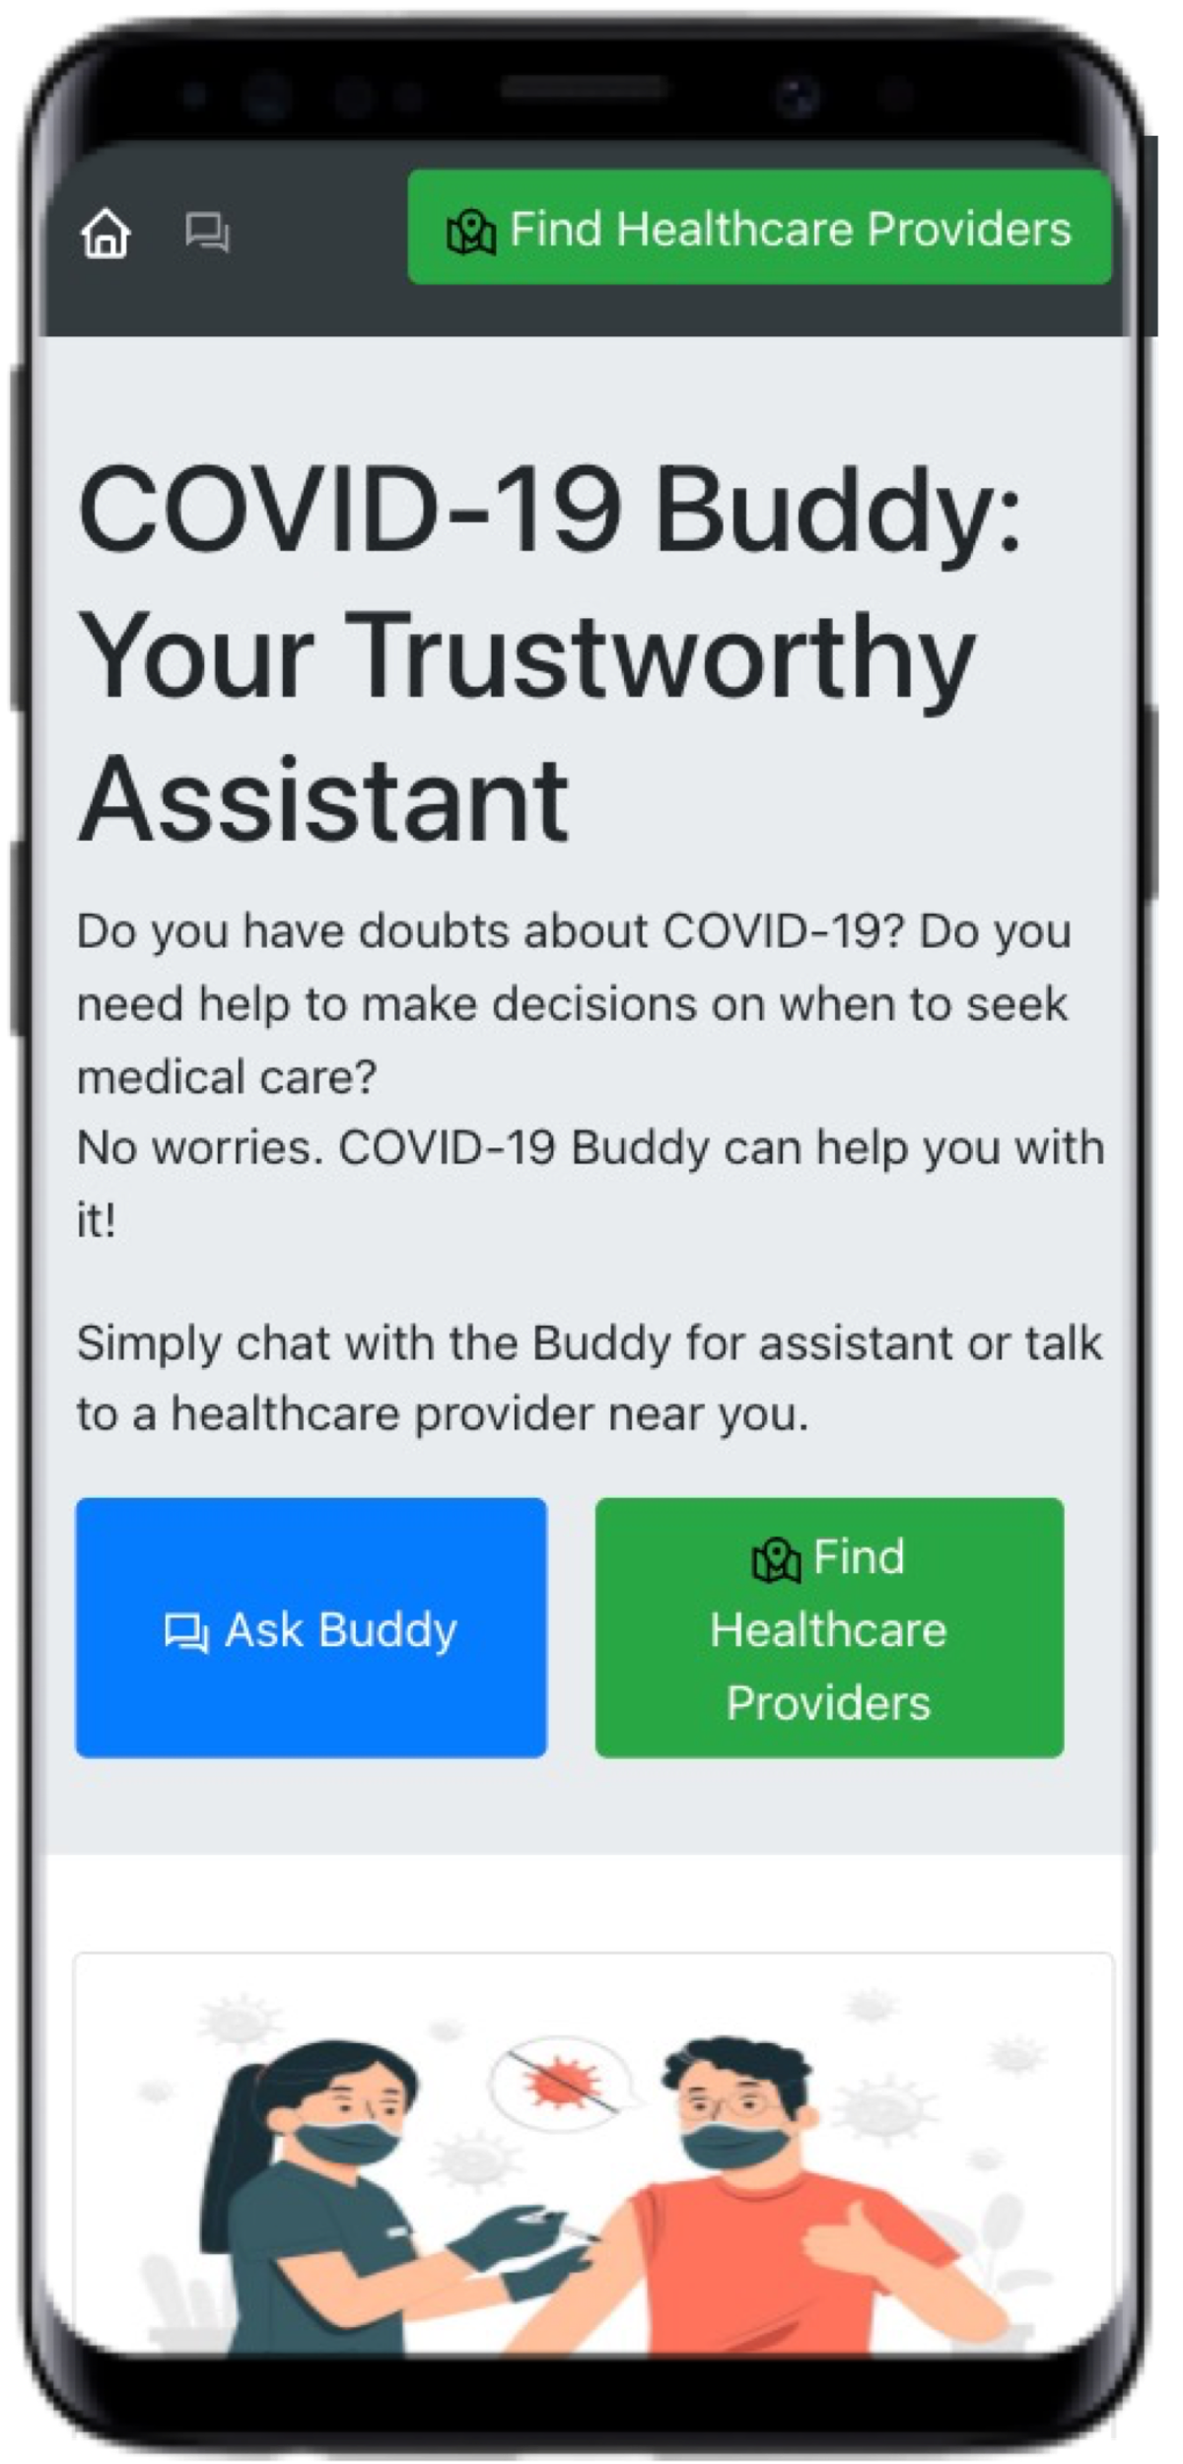

Slide 10
Buddy
Quick Guide

Slide 11
Quick Guide

Slide 12
Buddy
Quick Guide

Slide 13




Buddy
FAQs
Buddy
Checker

Slide 14
Buddy
FAQs
Buddy
Checker

Slide 15

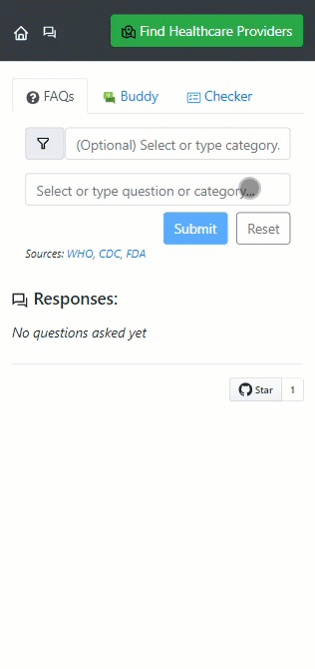
794 FAQs collected from WHO, CDC, FDA websites
AI + IQVIA HealthCare Locator SDK are integrated to suggest specialists nearby

Slide 16
Buddy
FAQs
Buddy
Checker

Slide 17

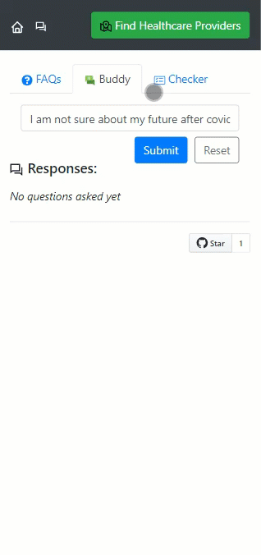
AI responds with a closest FAQ to a user’s question
AI + IQVIA HealthCare Locator SDK are integrated to suggest specialists nearby

Slide 18
Buddy
FAQs
Buddy
Checker

Slide 19

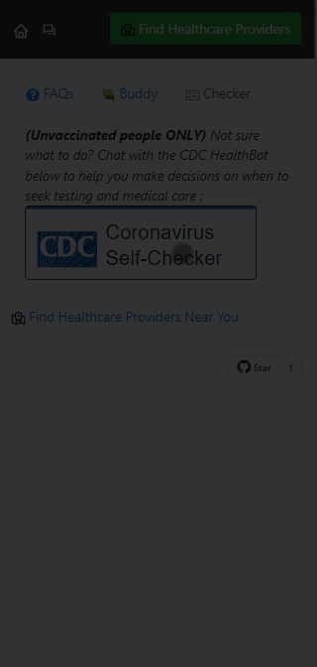
CDC HealthBot is embedded to help unvaccinated people make decisions whether to seek medical care
Contextual link to open IQVIA HealthCare Locator is provided

Slide 20
Fight COVID-19 disinformation & Lack of access to Healthcare with COVID-19 Buddy
visit
covid-buddy.herokuapp.com

